Slide 1
ownCloud Community Edition
Raju Vindane
Notes:
Welcome!

Slide 2

About Me
Raju Vindane, Passionate about OpenSource,
#Debian #OwnCloud #Diaspora #Privacy #Freedom

Slide 3

What Exactly is OwnCloud?
ownCloud is an open source file sync and share software for everyone from individuals operating the free ownCloud Community Edition, to large enterprises and service providers operating the ownCloud Enterprise Edition.

Slide 4
What can you do with ownCloud?

Slide 5
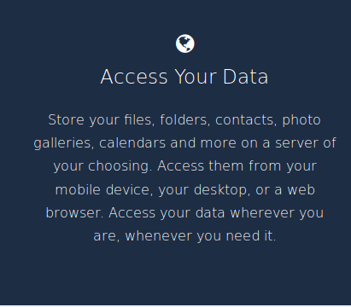

Slide 6
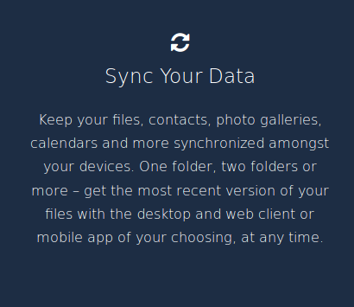

Slide 7
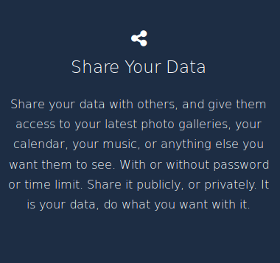

Slide 8
But all of these are also possible with Google Drive, Apple iCloud & Dropbox..
So why do you need OwnCloud?

Slide 9
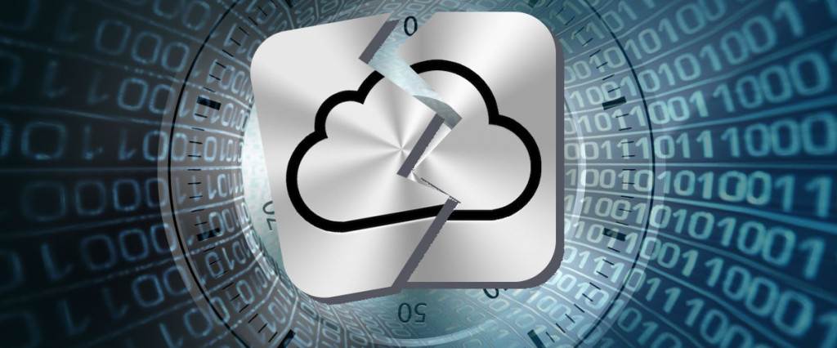
Privacy
#NSA #PRISM #WikiLeaks #Assange #Edward Snowden

Slide 10
About ownCloud
File sync and share
Open Source
Easy to use
Easy to install
Easy to extend
>2 million users!
Notes:
OwnCloud is a file sync and share technology. You run ownCloud on your own server or pick one of the 30+ ownCloud providers.
Both server and clients are open source and are developed with the goals of being easy to install, use and extend.
ownCloud has over 2 million users, making it by far the most popular open source file sync and share technology.

Slide 11
ownCloud Open Source Momentum
Total of 57,000 commits by 550 contributors, 1,500 commits per month
More than just File Sync and Share
  Powerful application and integration platform
  7-10 apps are updated or released per week
  top 10 apps have between 11,000-26,000 downloads
Notes:
Aside from having many users, ownCloud also has a large development community.
In part that is because ownCloud is more than sync and share. Our apps bring functionality like calendar and contacts, mail, notes and much more to ownCloud.

Slide 12
ownCloud -- For end users
Notes:
Let's talk about what ownCloud has to offer for end users.

Slide 13
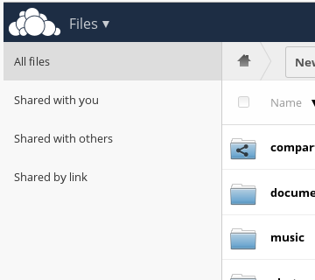
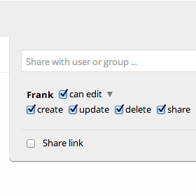
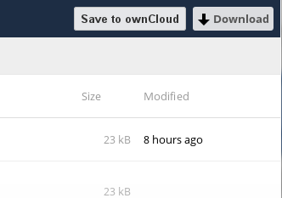
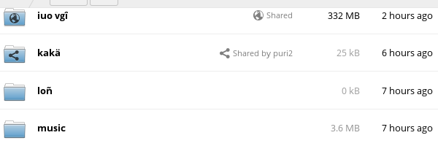
Sharing
Notes:
Sharing is an important aspect of ownCloud. ownCloud shows you who shared what with whom and how and lets you set precise permissions, expiration dates and passwords on shares, both for sharing links and for shares with other users on your ownCloud.

Slide 14
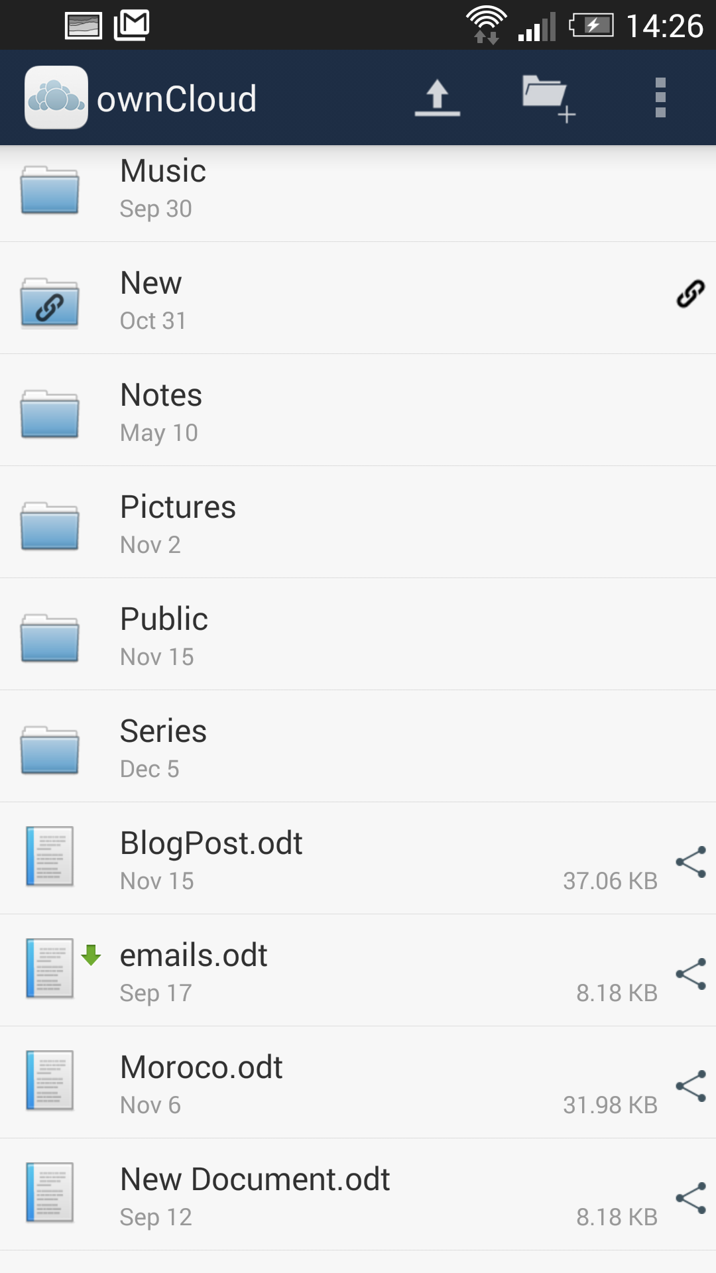
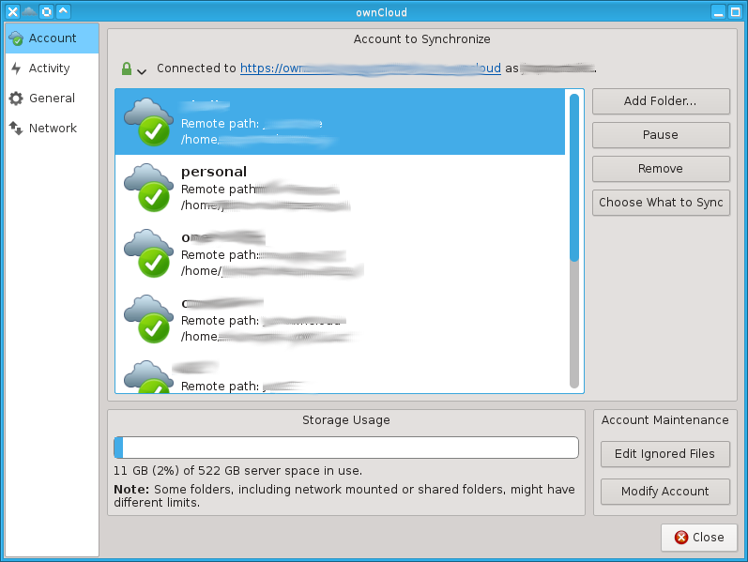
Syncing apps
Notes:
ownCloud offers sync apps for Windows, Mac and Linux as well as Android and iOS. Third party apps exist for Windows Mobile and Sailfish and there are loads of external apps with ownCloud integration thanks to our open source android and iOS integration libraries.

Slide 15
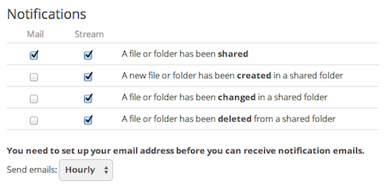
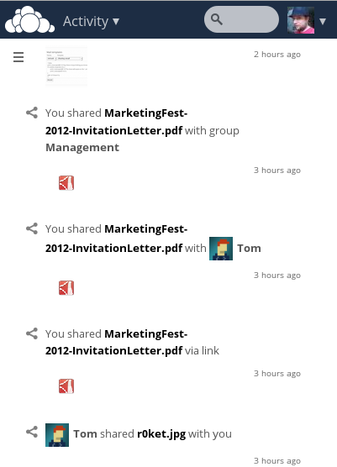
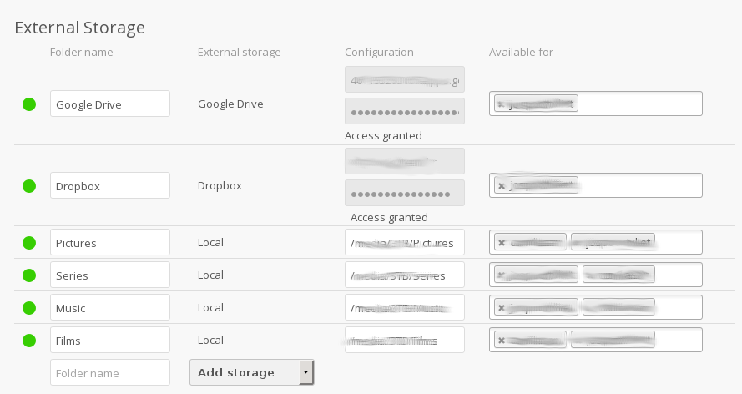
Features
Notes:
Let me mention some other ownCloud features.
ownCloud seamless integrates external storage and with the Encryption app you can encrypt the data on external storage!
The Activity app shows what happened in your ownCloud and sends you notifications.

Slide 16
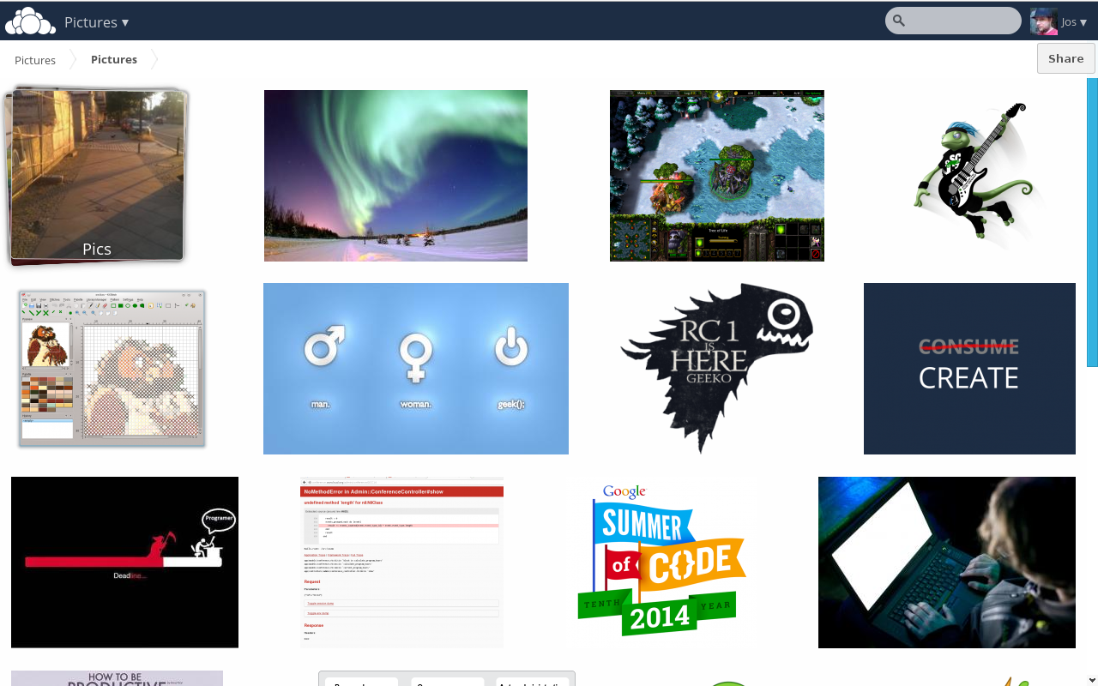
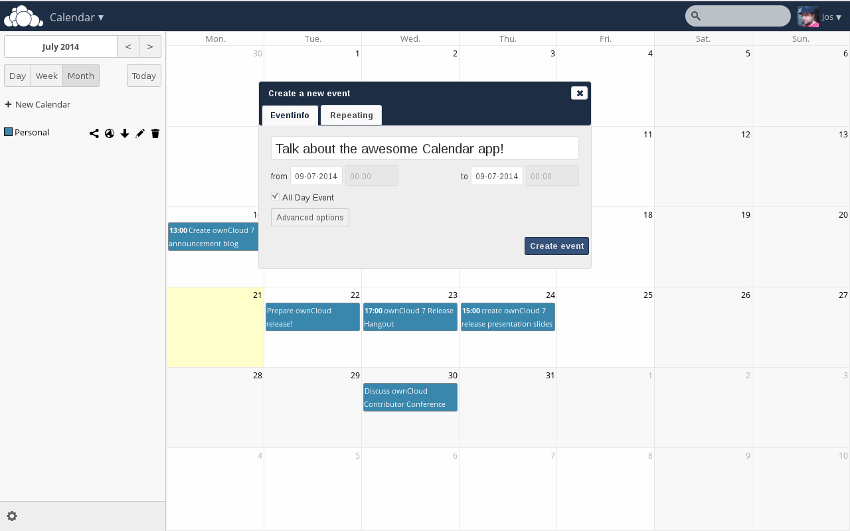
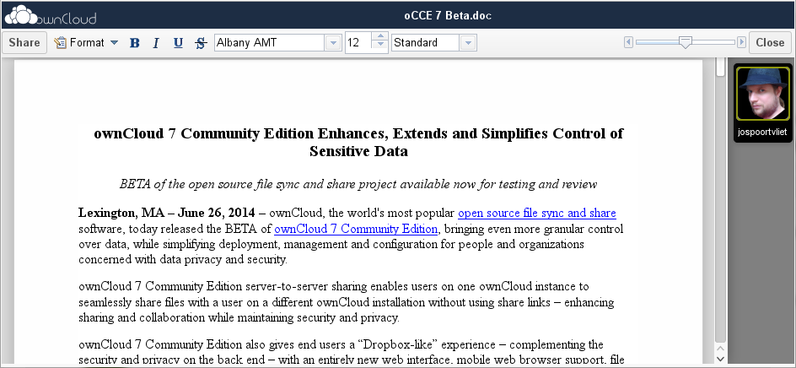
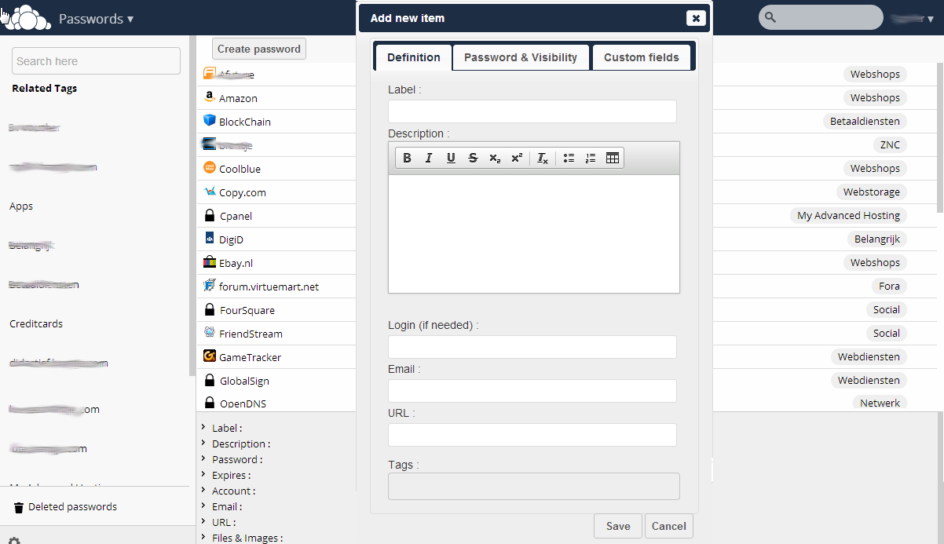
More apps
Notes:
Last but not least, there are the ownCloud apps, like Gallery, Documents (with collaborative editing!), calendar and contacts and many others like a password manager, mail, bookmarks and so on.

Slide 17
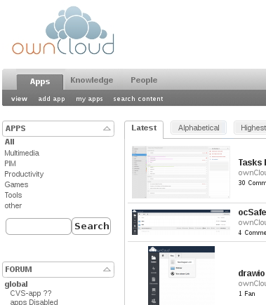
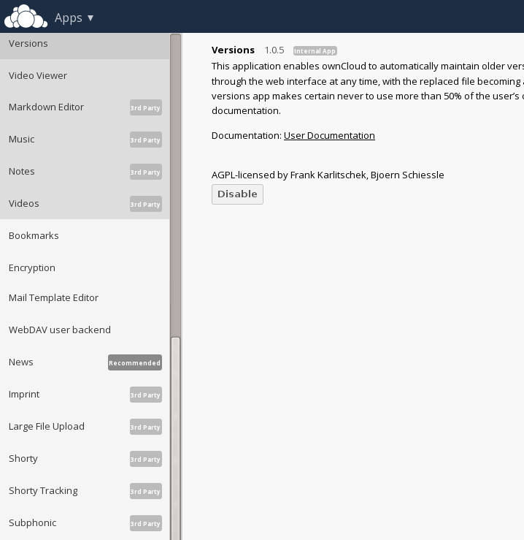
App management
Notes:
Apps can be installed from the ownCloud App manager or from the ownCloud app store, which features over 200 ownCloud apps!

Slide 18
ownCloud--For administrators
Notes:
ownCloud is easy to maintain, but gives a lot of control to system administrators.

Slide 19
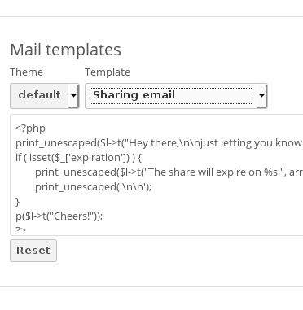
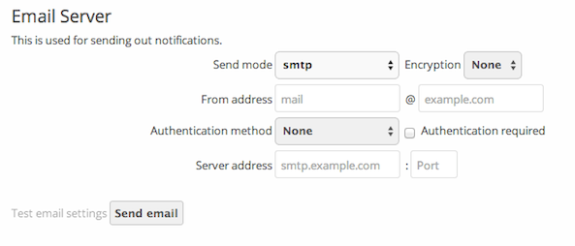

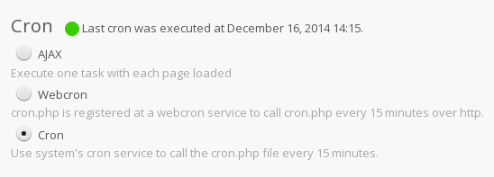

Management
Notes:
ownCloud makes it easy to manage your installation. It warns you about security issues and other problems, lets you fine-tune what your users can and can't do and all that in an easy user interface.

Slide 20
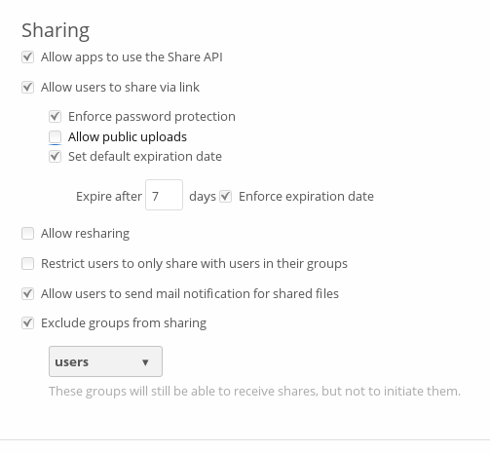
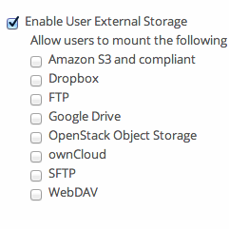
Control Sharing
Notes:
You can control sharing and the use of external storage to protect your users' data

Slide 21
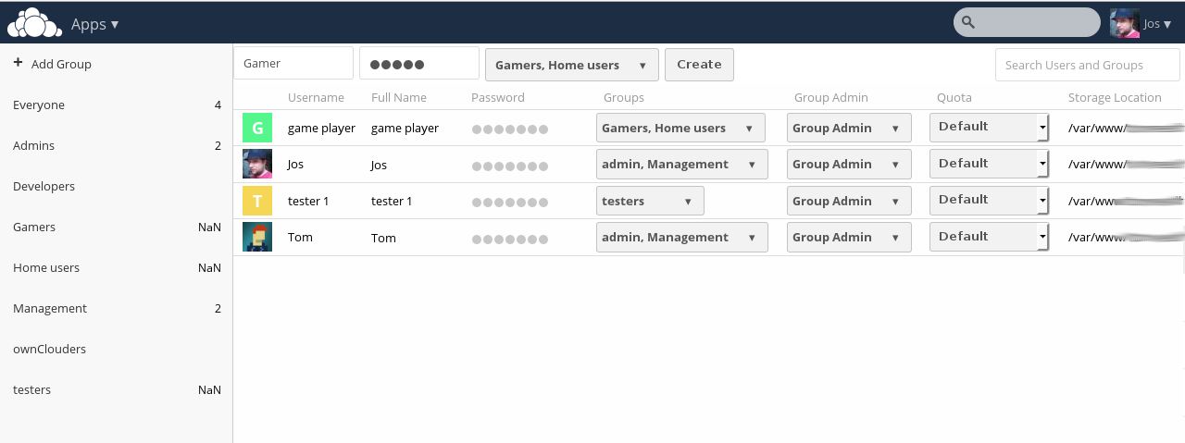
User management
Notes:
And of course manage the users themselves, with groups and permissions.

Slide 22
ownCloud -- For developers
Notes:
ownCloud is always looking for developers. We offer easy API's to develop apps with and of course welcome contributions to the existing apps and core of ownCloud.

Slide 23
App developers
API inspired on Rails and Symfony
Generator for base app with dependency injection, routing, database layer, middleware and controllers
doc.owncloud.org & #owncloud-dev
Third party developers
Pub/sub model Webhooks
API for sharing, list, up/download etc

Slide 24
Enough Talk,
Lets do some real stuff

Slide 25
Installation of OwnCloud

Slide 26
What you need?
Ok, first things first. Let’s look at what you will need in order to get your ownCloud server up and running. There are a number of things you need, namely the hardware required. Here is a full list:
A spare machine to install ownCloud on.
Enough hard drive space to fit all of your cloud files and the operating system.
A good quality internet connection (so that syncing is quicker – this isn’t a requirement but it helps).
A cabled internet connection – again, this isn’t a requirement but it will speed things up considerably over wireless.
A usb stick/CD pre-loaded with Debian/Ubuntu Server Edition. I would recommend 12.04 LTS x64. Or any Server Distro that you are comfortable with can do.
Access to your firewall/router to make changes to the rulebase.

Slide 27
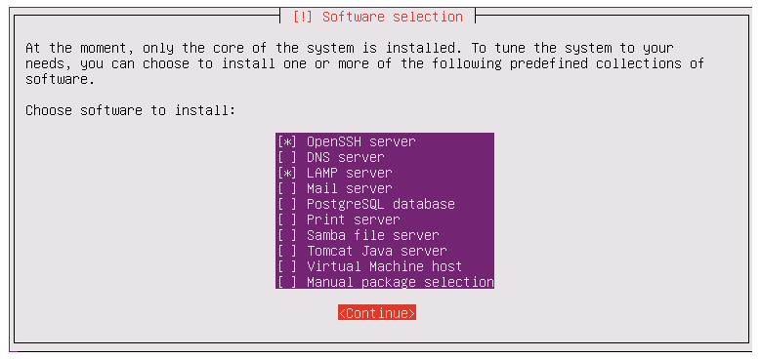
Installing a Server OS on your Machine

Slide 28
Install Webmin
Webmin gives you an easy to use web interface so that you can easily manage your server from your browser. I personally love this application as this coupled with SSH access gives you fantastic control over your machine.
Webmin.com

Slide 29
Install OwnCloud
Now we’re ready to install ownCloud. This is a very simple process. All you need to do is download the compressed file, extract it to your home folder and then move it to Â /var/www.
wget http://owncloud.org/releases/owncloud-5.0.0.tar.bz2
tar -xvfÂ owncloud-5.0.0.tar.bz2
sudo mv owncloud /var/www/owncloud
sudo chown -R www-data:www-data /var/www/owncloud
sudo /etc/init.d/apache2 restart

Slide 30
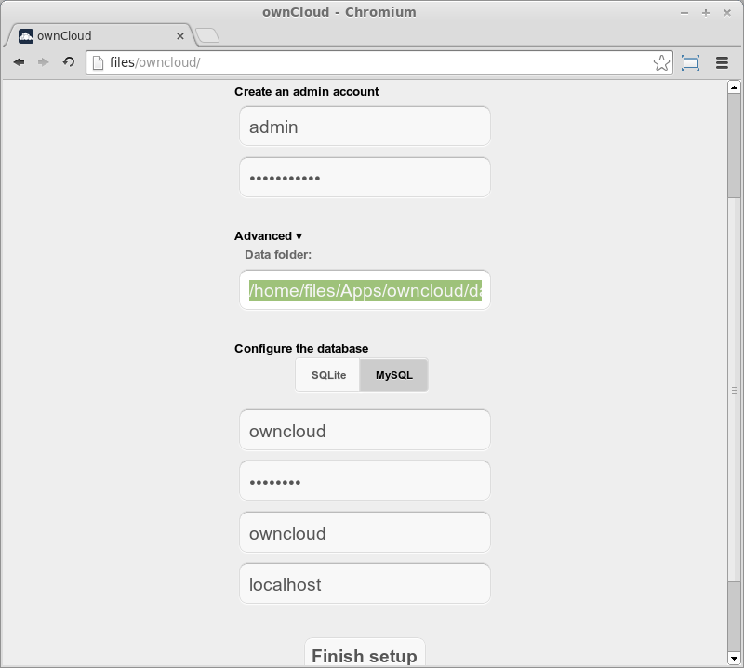

Slide 31
Uploading big files > 512MB (as set by default)
The default maximum file size for uploads is 512MB. You can increase this limit up to what your filesystem and operating system allows.
To view your current PHP configuration and to see the location of your php.ini file
upload_max_filesize = 16G
post_max_size = 16G

Slide 32
Configuring your Firewall & Network Card
You need to give your server a static IP address.
This will ensure that if you ever need to reboot your ownCloud server, it will always keep the same IP address and your NAT rules will always work.
The easiest way of doing this is through Webmin. To do this go to Networking > Network Configuration > Network Interfaces. You will then see a screen a lot like this:

Slide 33
Getting on the Internet
Use DNS Service from no-ip.com

Slide 34
Links
Get it on owncloud.org/download
Try it on demo.owncloud.org
Join on owncloud.org/contribute
Find help on doc.owncloud.org
For large scale use see ownCloud.com

Slide 35
Before you leave one more thing.

Slide 36


Slide 37

Hamaralinux.org

Slide 38
OwnCloud -- Questions?
rajudv on Diaspora
On twitter as @rajuvindane
facebook.com/rajudv
rajuvindane@cryptolab.net

